Slide 1


OPEN SOURCE PLASTIC
RECYCLING MACHINE
Mardi 8 Février - Jalon L2
Notes:
Willie

Slide 2





- Table of contents -
A - Context of the study
B - Relevant (new) elements of State of the art
C - Current developments
D - Project task advancement, achieved work plan and risk analysis
E - Project costs
F - Work Plan
Notes:
Willie

Slide 3

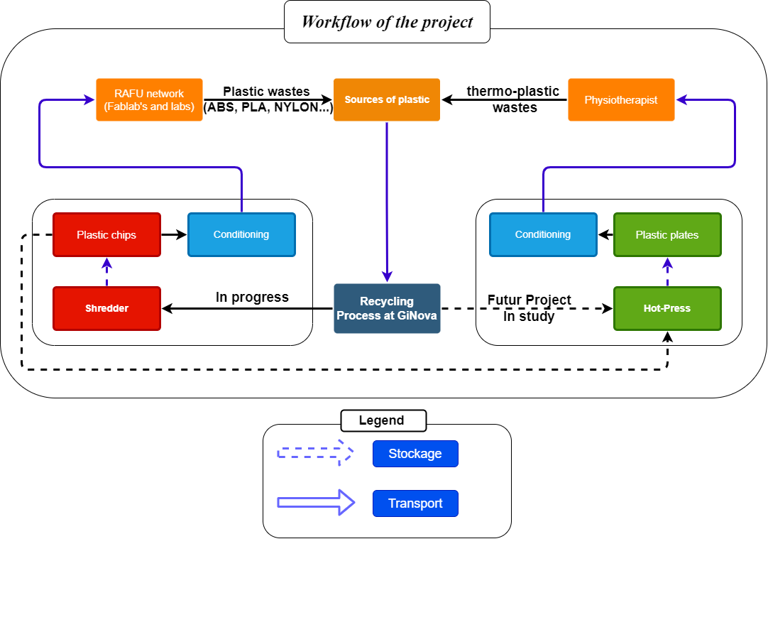
CONTEXT OF THE STUDY
Symbols
Notes:
Willie

Slide 4
- Table of contents -
A - Context of the study
B - Relevant (new) elements of State of the art
C - Current developments
D - Project task advancement, achieved work plan and risk analysis
E - Project costs
F - Work Plan
Notes:
William

Slide 5
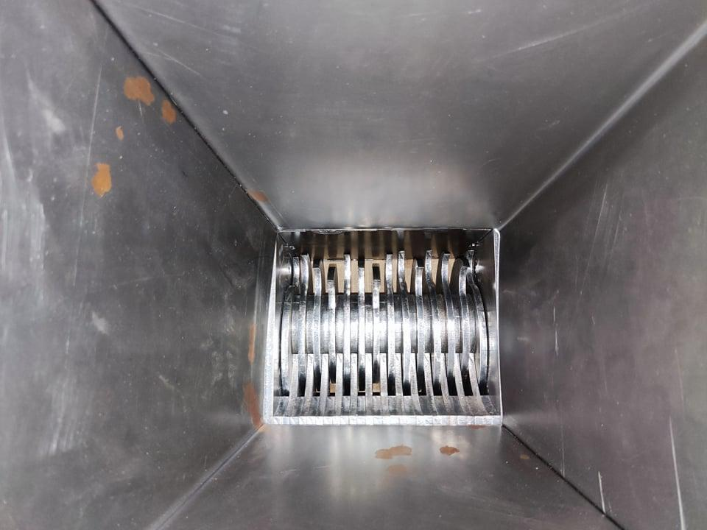
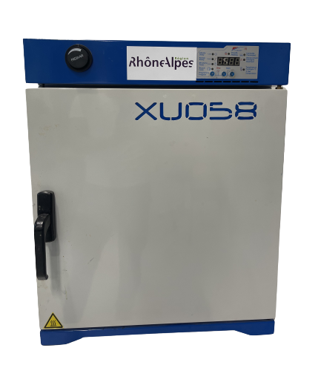
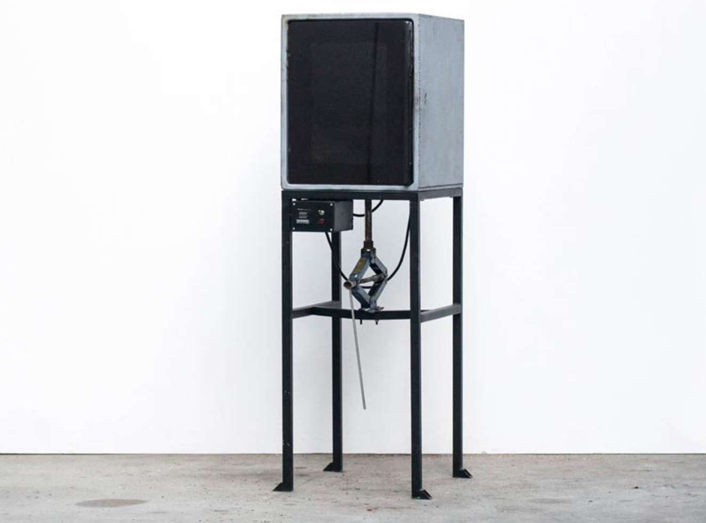
RELEVANT (NEW) ELEMENTS OF STATE OF THE ART
Shredder
Dryer
Hot-press
Notes:
William

Slide 6
- Table of contents -
A - Context of the study
B - Relevant (new) elements of State of the art
C - Current developments
D - Project task advancement. achieved work plan and risk analysis
E - Project costs
F - Work Plan

Slide 7
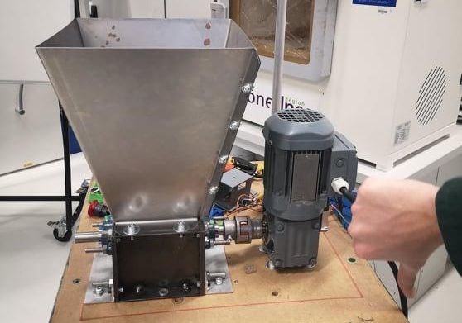

CURRENT DEVELOPMENTS - SHREDDER
First assembly
3 phases motor 180 W-60 N.m
1.5 kw converter
Rotex 65 N.m coupling joint
Engine stalling -
Not enough torque

Slide 8
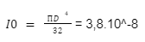
CURRENT DEVELOPMENTS - SHREDDER
Maximum transmissible torque of the input shaft
Hypothesis :
Shaft diameter : 25 mm
Rg_{Steel} (elastic limit of sliding) = 150 Mpa
Safety factor : s=1
Maximum input torque : 460 N.m

Slide 9
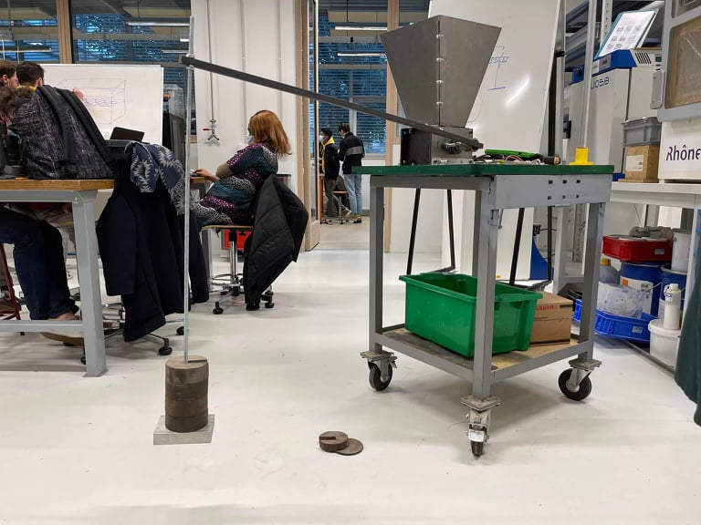
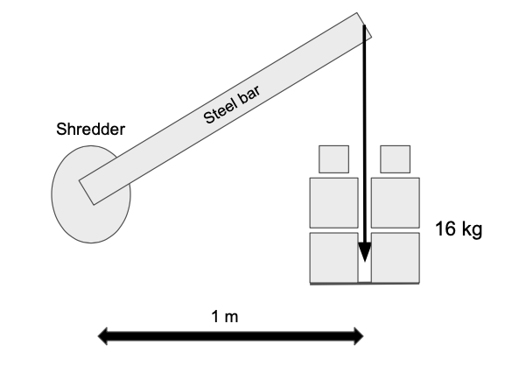
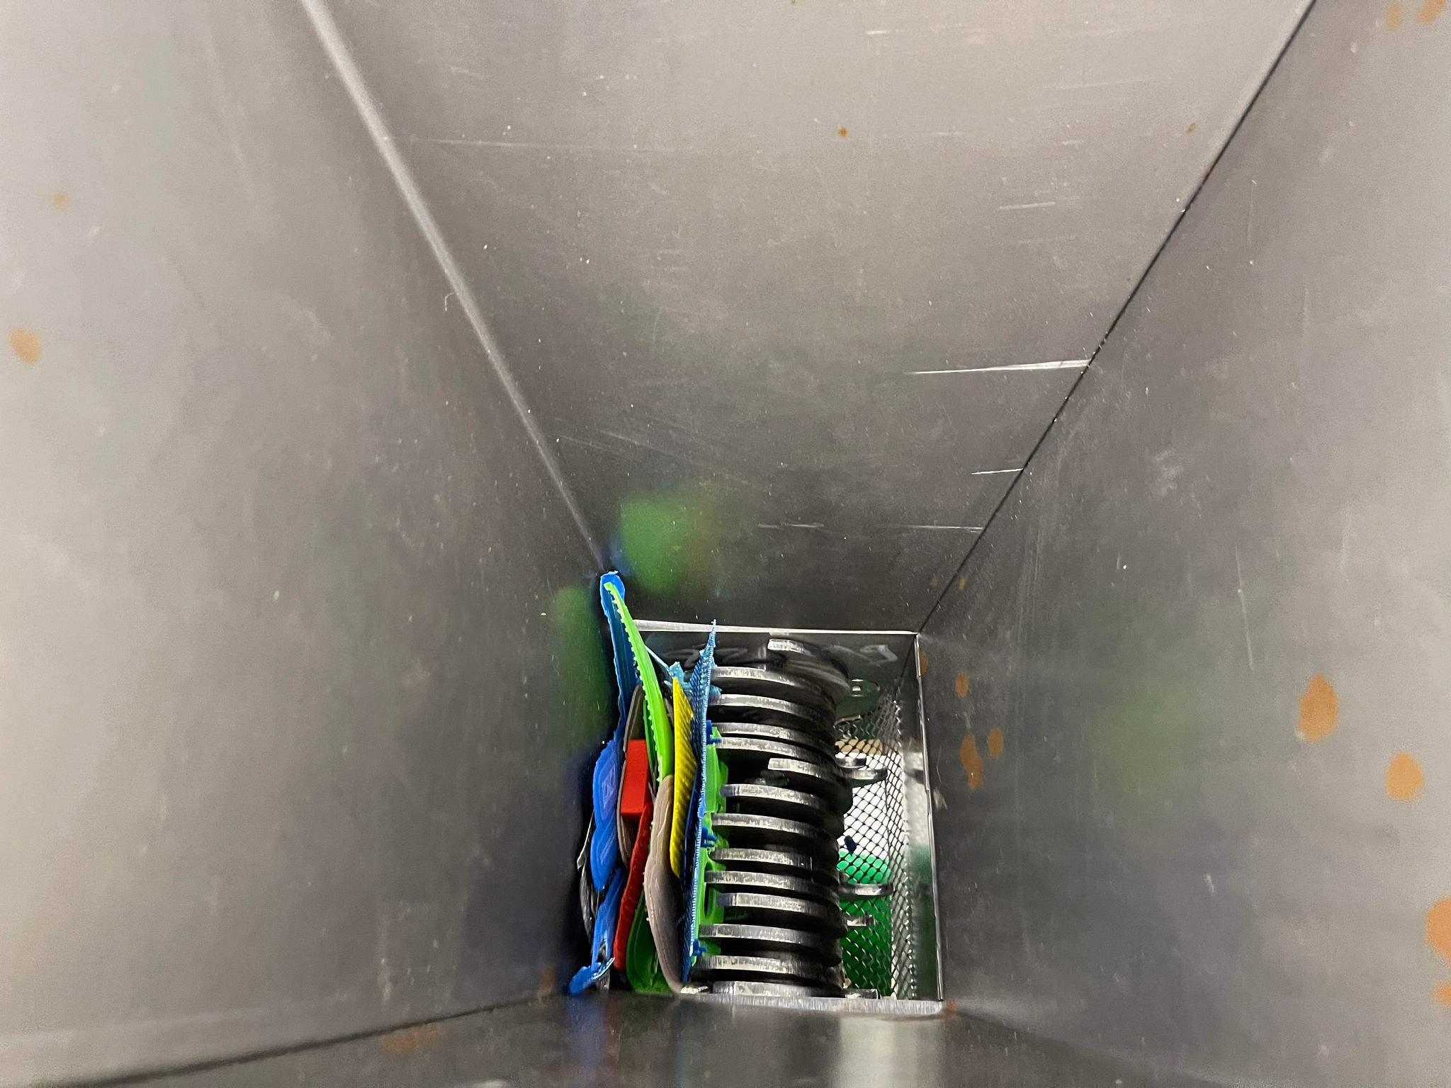
CURRENT DEVELOPMENTS - SHREDDER
Minimum transmissible torque of the input shaft
Minimum torque : 160 N.m

Slide 10
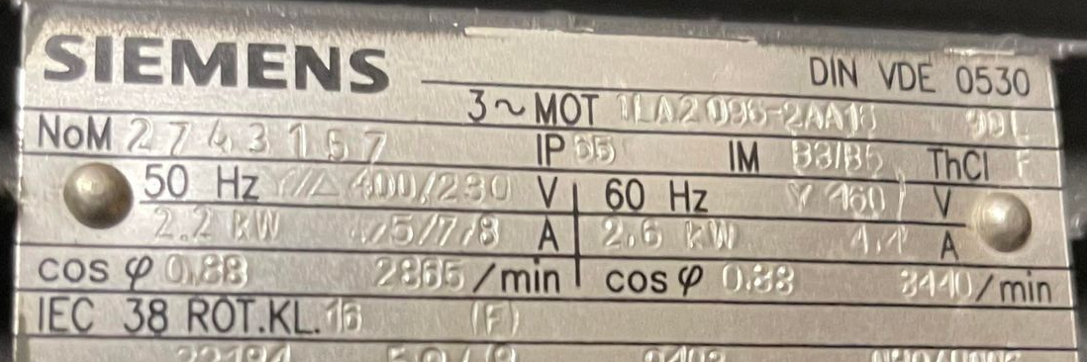
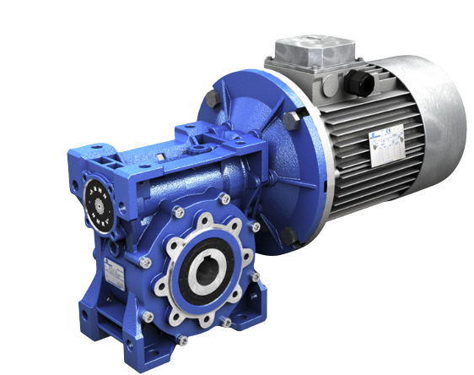
CURRENT DEVELOPMENTS - SHREDDER
Transmission choice
2.2 kW three-phase Siemens Motor- 7.33 N.m for N= 2865 rpm.
If we take a ratio of 1/40 :
Output speed at the gearbox is 70 rpm (which is the value recommended by the precious plastic community)
The output torque would be 293 N.m
160 < 293 < 460

Slide 11
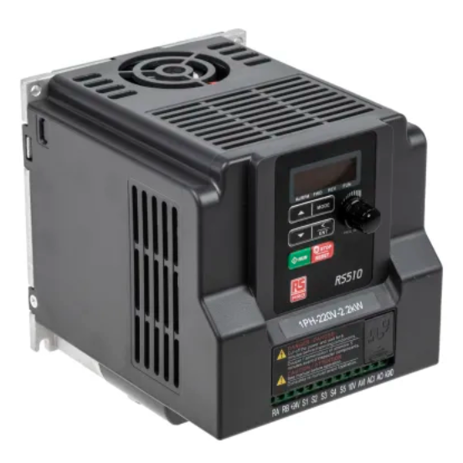
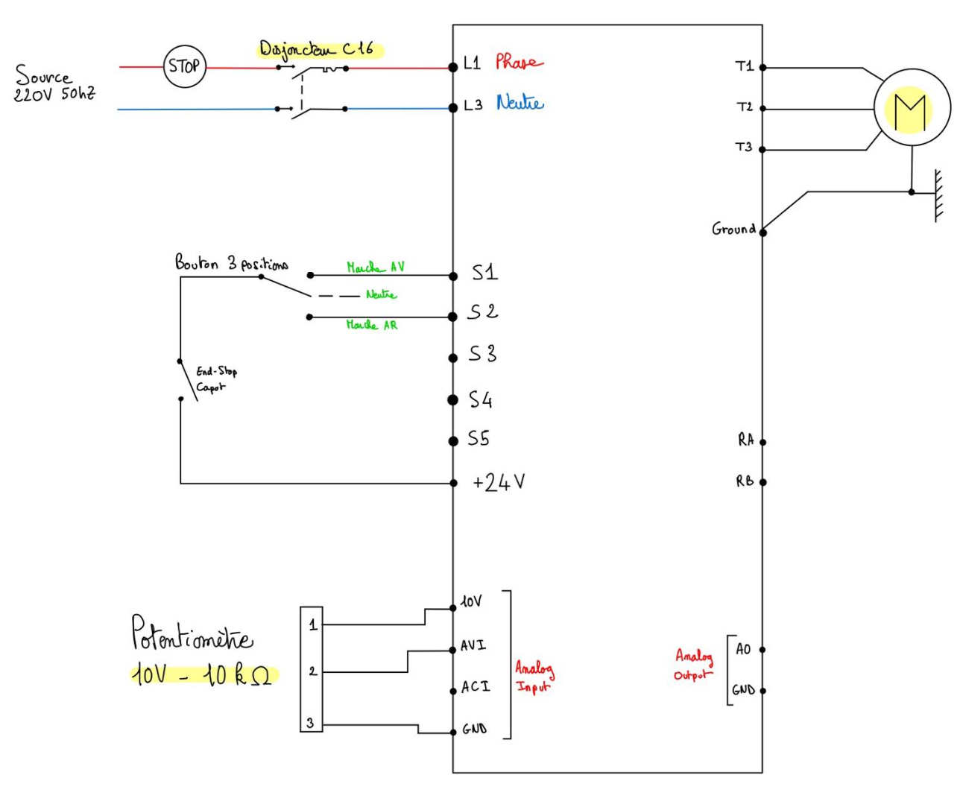
CURRENT DEVELOPMENTS - ELECTRICAL PART
Converter
wiring diagram
Notes:
Maxime

Slide 12
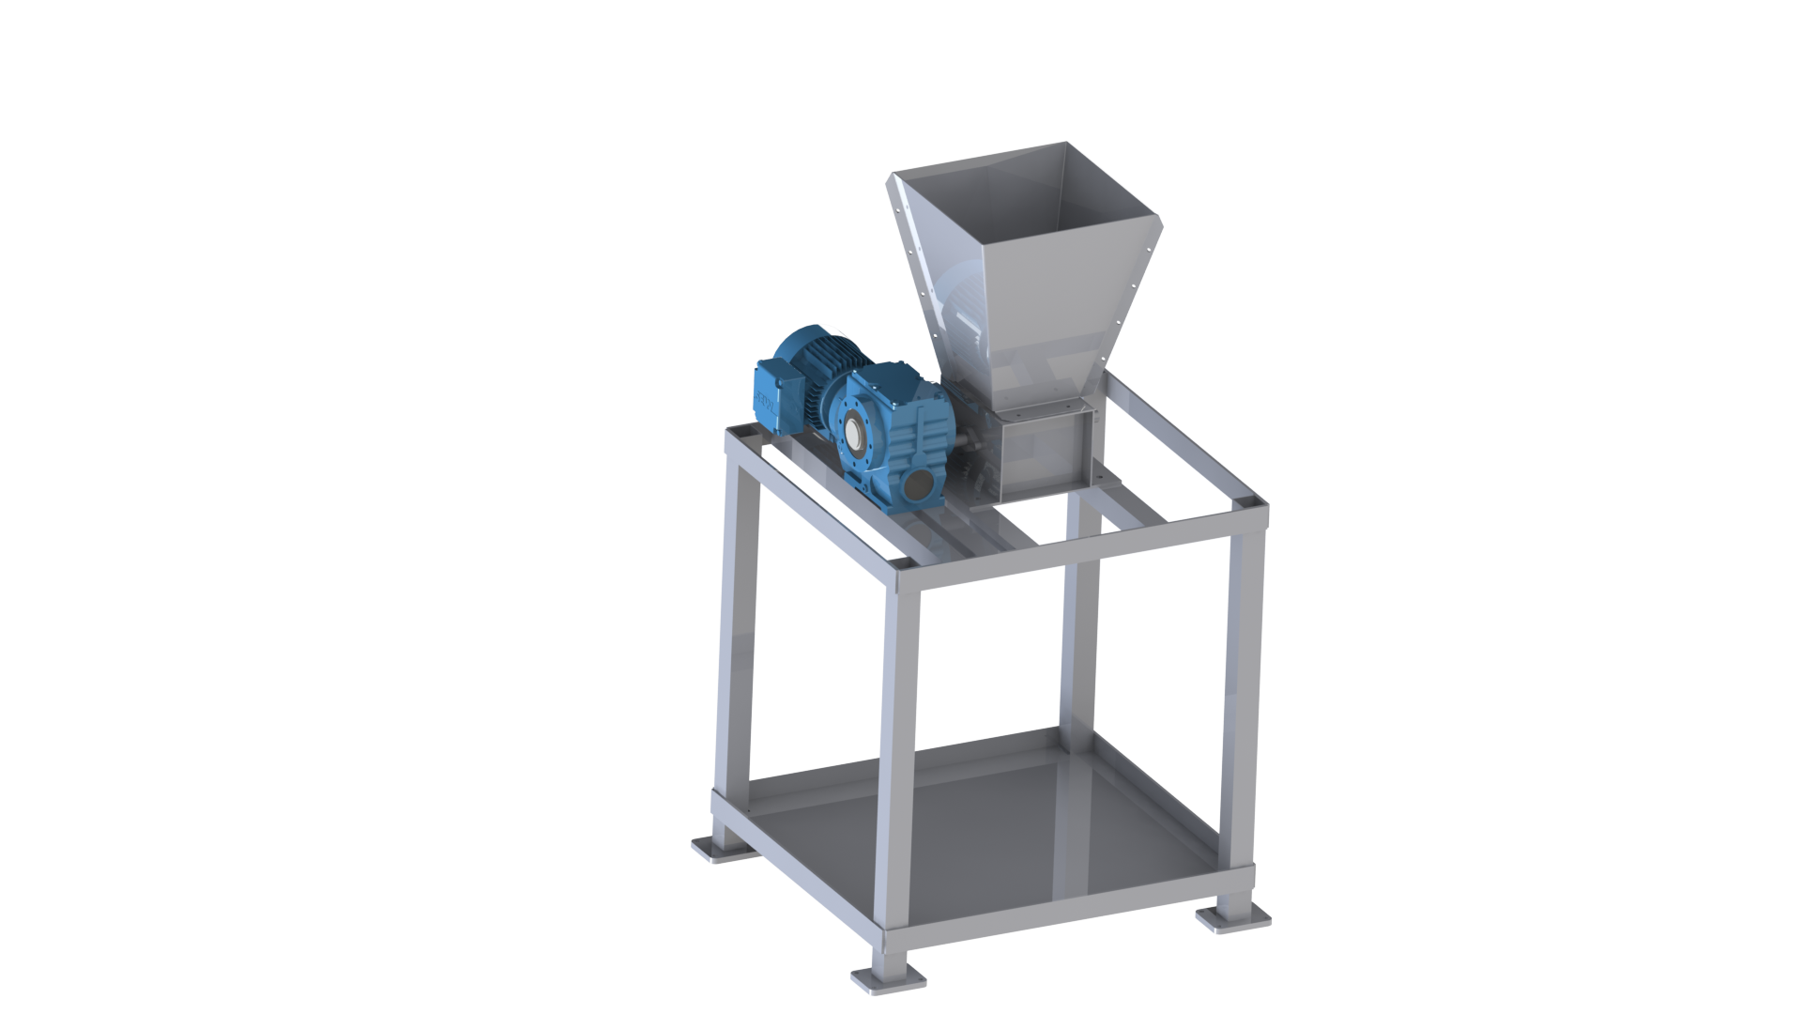
CURRENT DEVELOPMENTS - CAD
Notes:
Maxime

Slide 13
- Table of contents -
A - Context of the study
B - Relevant (new) elements of State of the art
C - Current developments
D - Project task advancement, achieved work plan and risk analysis
E - Project costs
F - Work Plan
Notes:
Margaux

Slide 14
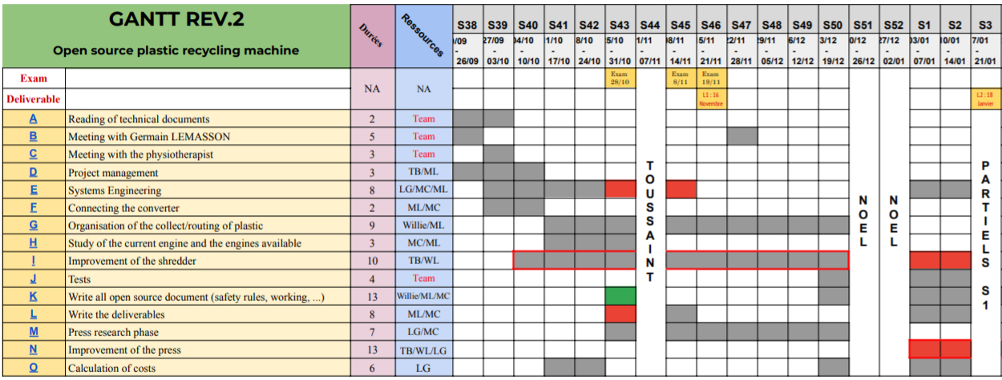
PROJECT TASK ADVANCEMENT
Gantt revision 2
Notes:
Margaux
Let's take a quick look at the evolution of the gantt chart since the last deliverable. We can see that we have managed to finish some tasks in the given time. However, with the first tests on the shredder after the Christmas holidays, we realized that the engine was unable to shred ABS pieces

Slide 15
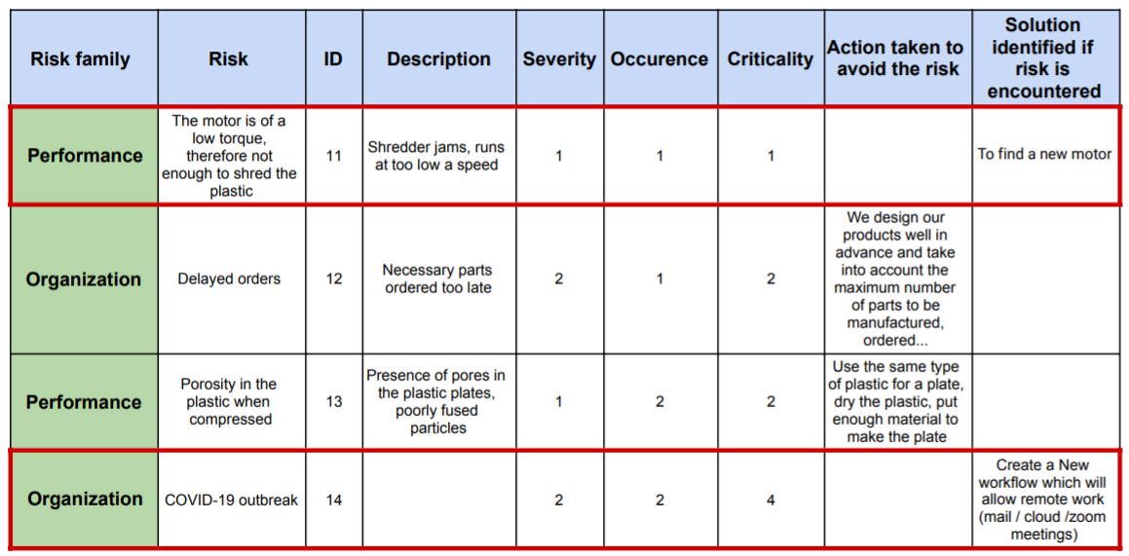
PROJECT TASK ADVANCEMENT
Extract of the risk analysis
Notes:
Margaux
This problem was written in the risk analysis but it turned out that the criticality had been underestimated as can be seen in the risk analysis extract.

Slide 16
PROJECT TASK ADVANCEMENT
Gantt revision 2
Notes:
Margaux
This problem had an important impact on our gantt chart as we started to have delays on critical path tasks

Slide 17
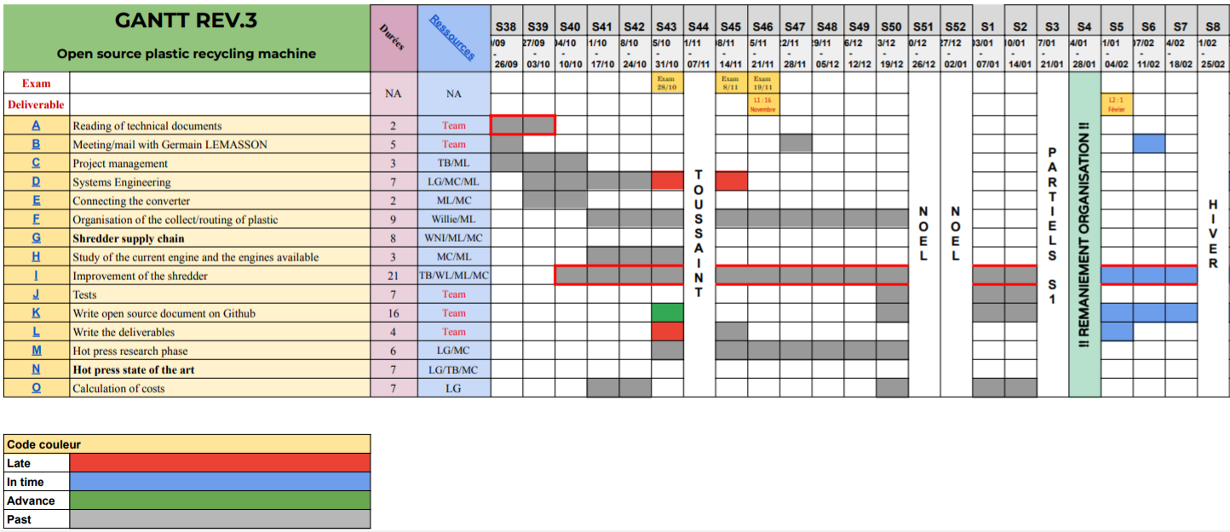
PROJECT TASK ADVANCEMENT
Gantt revision 3
Revision date : 25/01/2022
Notes:
Margaux
2 weeks ago, we decided to have a talk with the whole group about these delays which resulted in major modifications of the gantt and therefore a new revision. We refocused the objectives, and the decision that came out of our talk was to concentrate on the shredder until the end of the project and to give up the idea of being able to present a working prototype of the hot press. We have therefore replaced task N "Improvement of the press" of the Gantt revision 2 with "Hot press state of the art". Another change was to create a new task: 'Shredder supply chain'. For the next few weeks, we will focus on improving the shredder and writing open source documents on the github site.

Slide 18
- Table of contents -
A - Context of the study
B - Relevant (new) elements of State of the art
C - Current developments
D - Project task advancement, achieved work plan and risk analysis
E - Project costs
F - Work Plan
Notes:
Louis

Slide 19
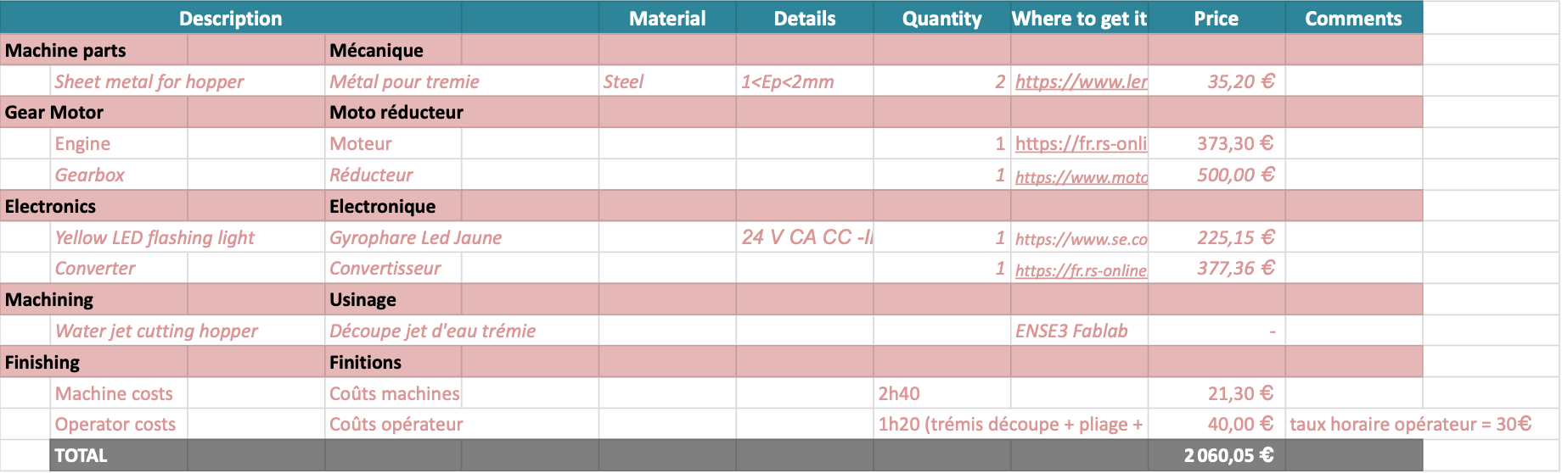
PROJECT COSTS
https://docs.google.com/spreadsheets/d/18o8vKLldMno5jiXbUUZbx3Ocs_Q6Qh4J/edit#gid=2011768120
Notes:
Louis

Slide 20
- Table of contents -
A - Context of the study
B - Relevant (new) elements of State of the art
C - Current developments
D - Project task advancement, achieved work plan and risk analysis
E - Project costs
F - Work Plan
Notes:
Maxime

Slide 21



WORK PLAN
Problem identification
Discussion
New objectives
→ Delay in the aaaprototyping
→ Engine is too aaaweak
→ Find the source aaaof the issues
→ Debate on the aaanew objectives
→ Focus on the design aaaof the shredder
→ Work on the supply
Chain
→ Create open aaadocumentation
Notes:
Maxime

Slide 22
Thank you
for your attention
Questions ?
Notes:
Maxime

Slide 23
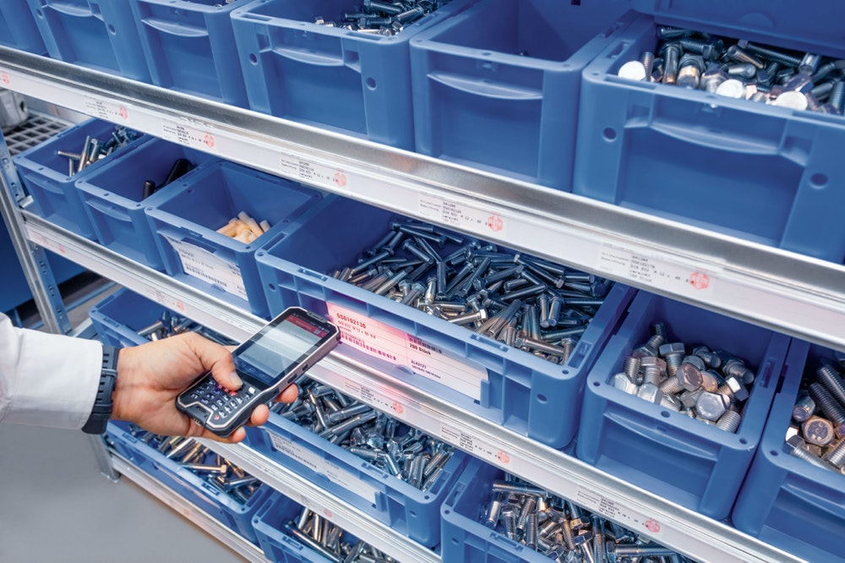
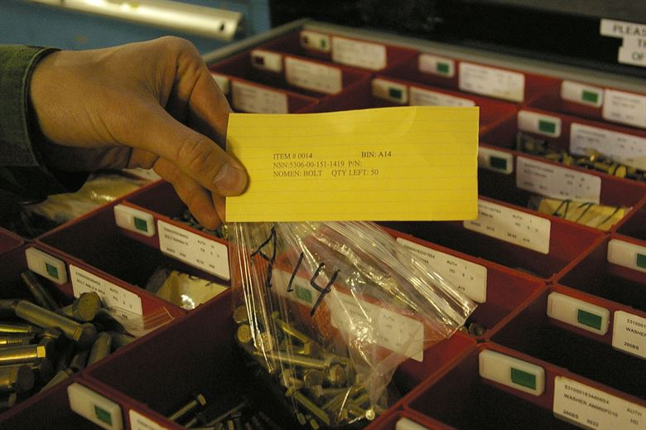
APPENDIX: Kanban method
Notes:
Maxime

Slide 24
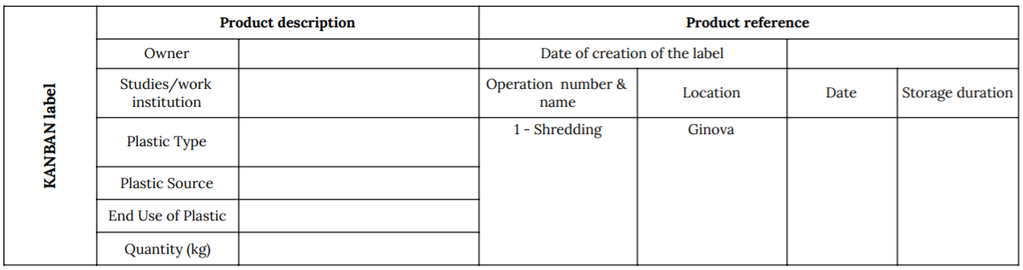
Notes:
Maxime

Slide 25
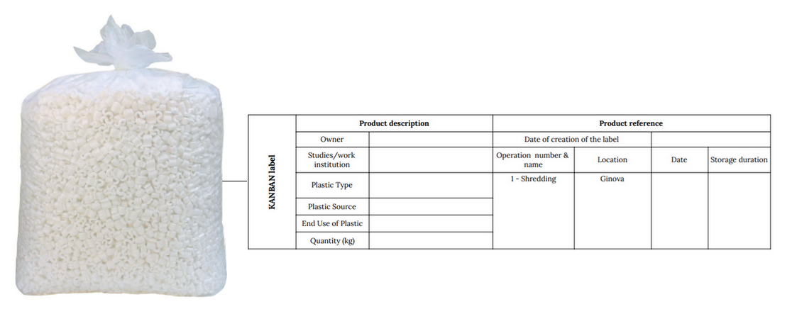
Notes:
Maxime

Slide 26
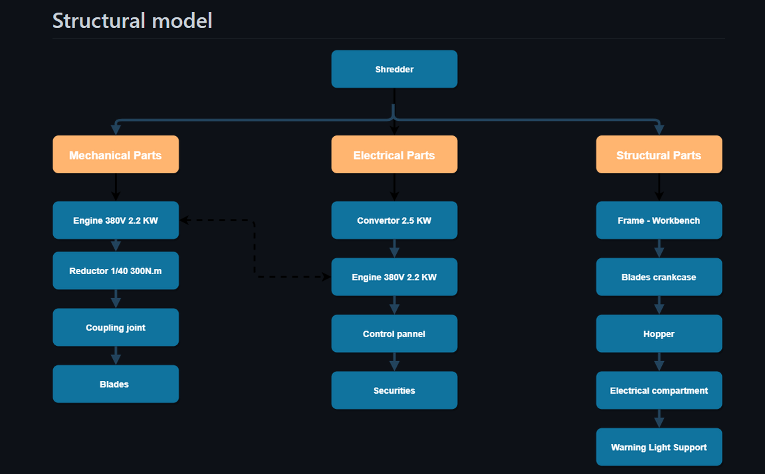
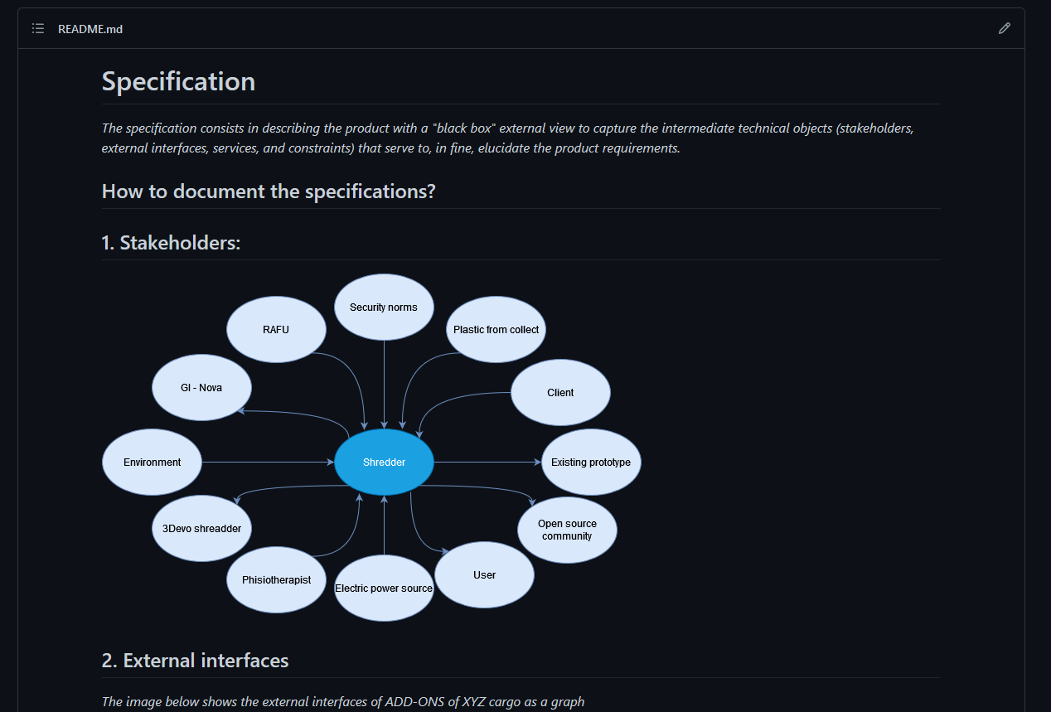
Notes:
Maxime

